Slide 1
CS294-129: Designing, Visualizing and Understanding Deep Neural Networks
John Canny
Fall 2016
CN: 34652
With considerable help from Andrej Karpathy, Fei-Fei Li, Justin Johnson, Ian Goodfellow and several others

Slide 2
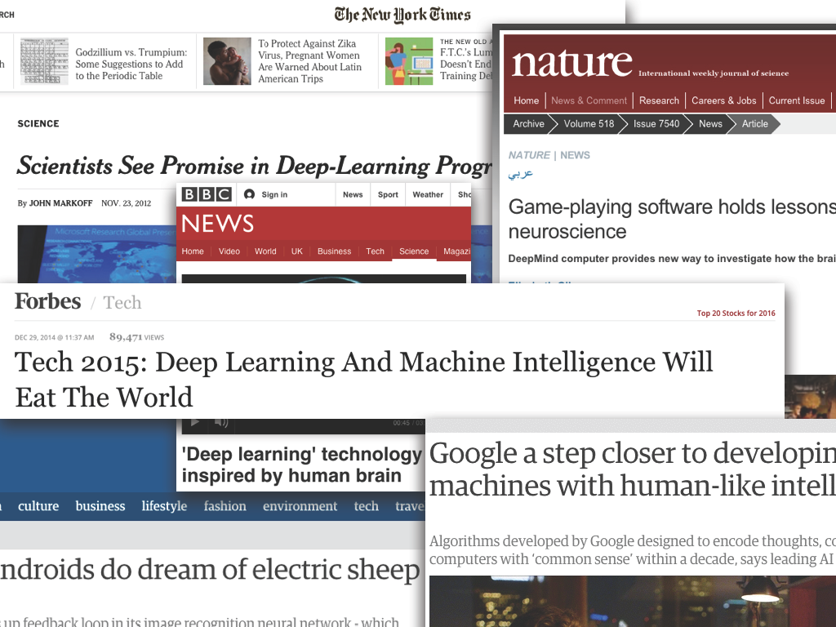
Deep Learning: Hype or Hope?

Slide 3
Deep Learning: Hype or Hope?
Hype: (n) “extravagant or intensive publicity or promotion”
Hope: (n) “expectation of fulfillment or success”

Slide 4
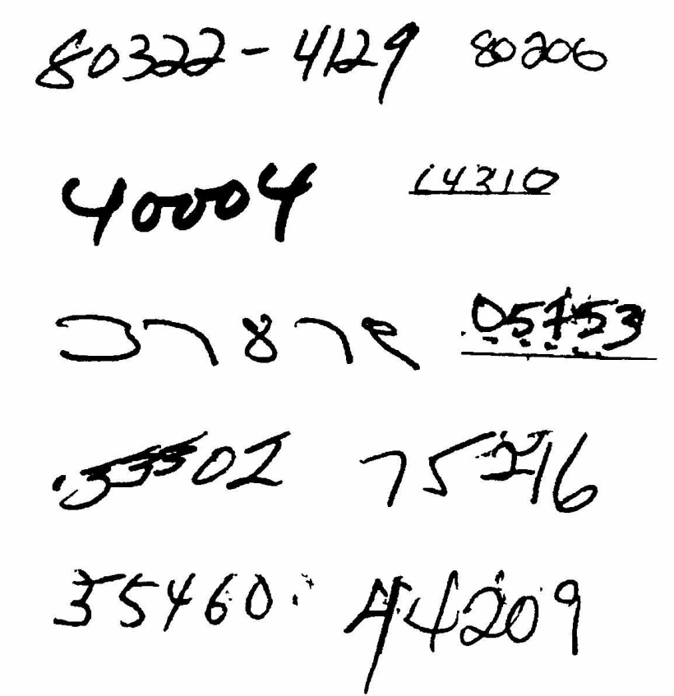
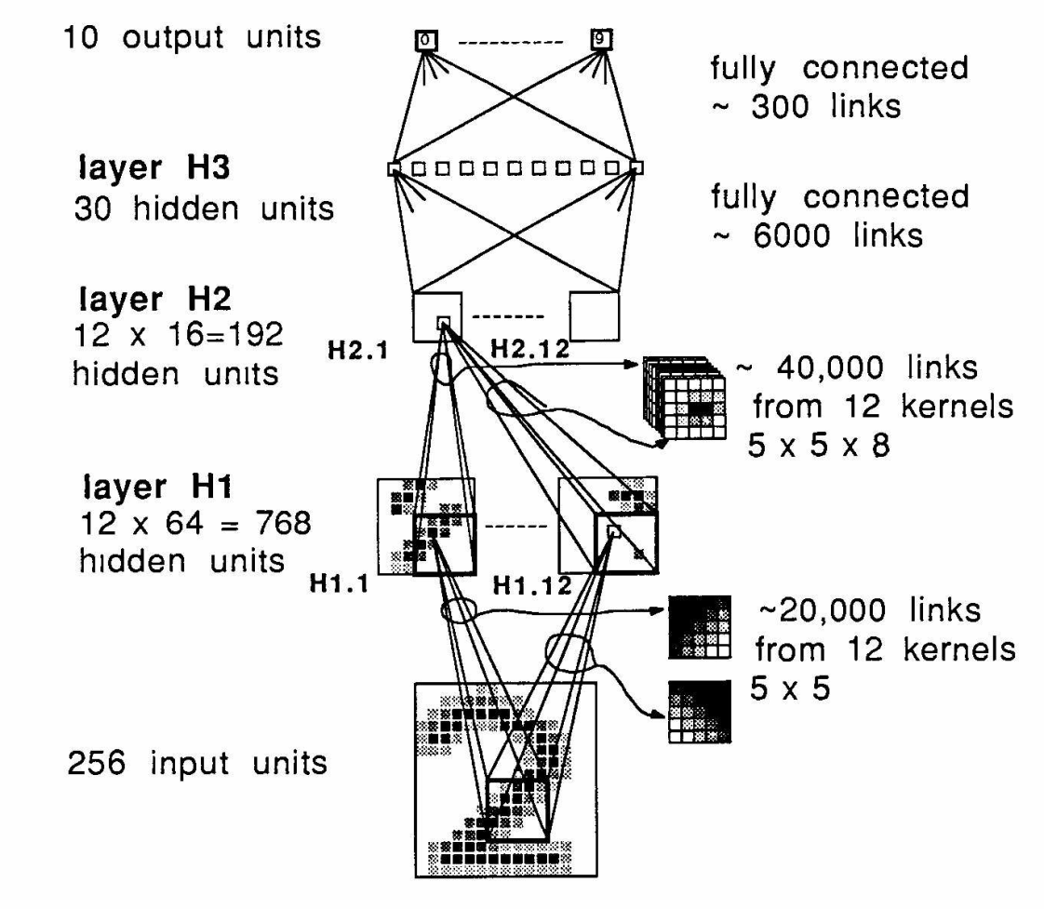
Milestones: Digit Recognition
LeNet 1989: recognize zip codes, Yann Lecun, Bernhard Boser and others, ran live in US postal service
Notes:
Around 5% error rate. Good enough to be useful.

Slide 5
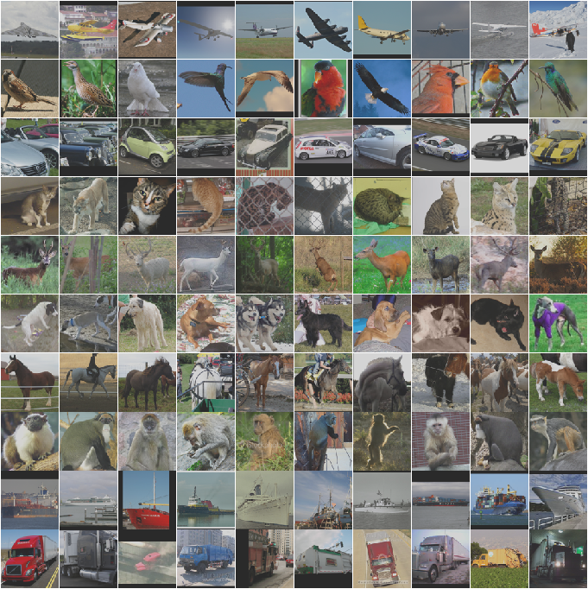
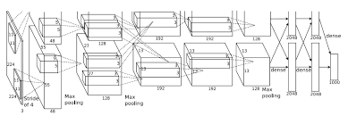
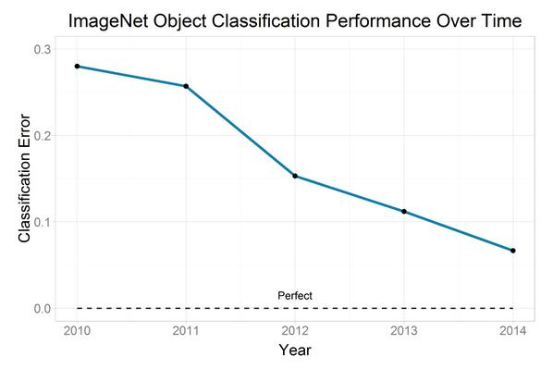
Milestones: Image Classification
Convolutional NNs: AlexNet (2012): trained on 200 GB of ImageNet Data
Human performance 5.1% error

Slide 6
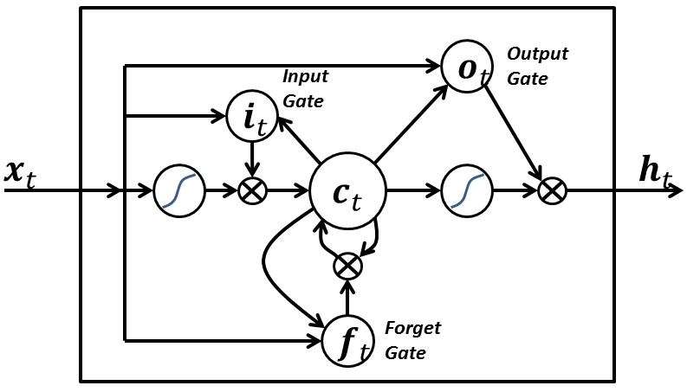
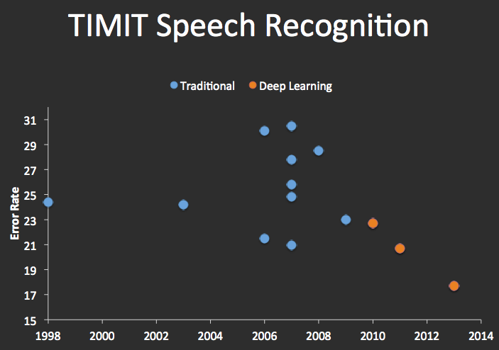
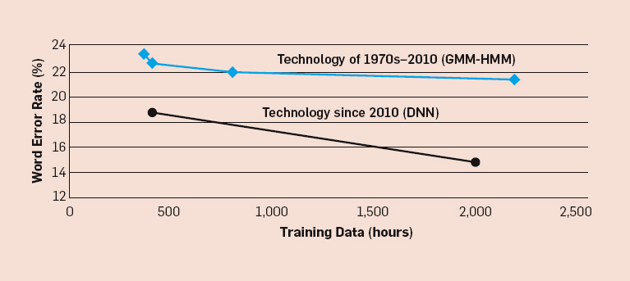
Milestones: Speech Recognition
Recurrent Nets: LSTMs (1997):

Slide 7
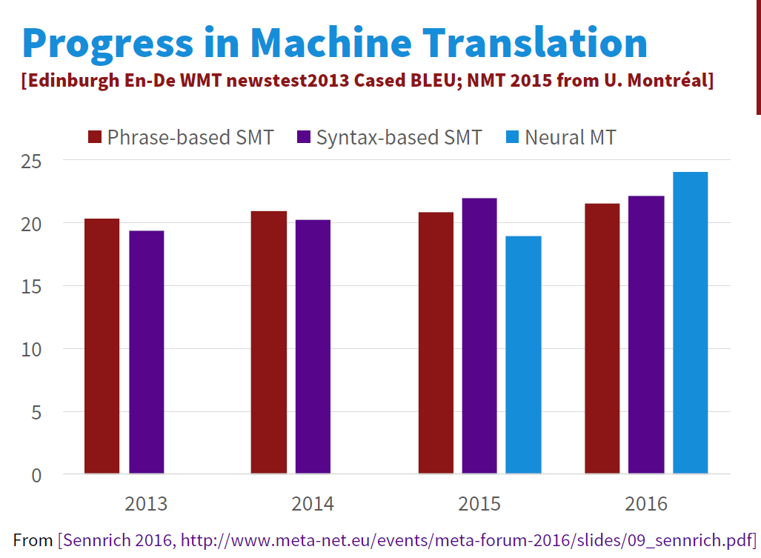
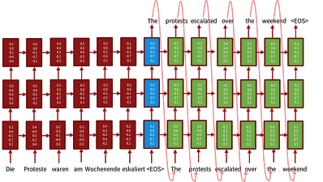
Milestones: Language Translation
Sequence-to-sequence models with LSTMs and attention:
Source Luong, Cho, Manning ACL Tutorial 2016.

Slide 8
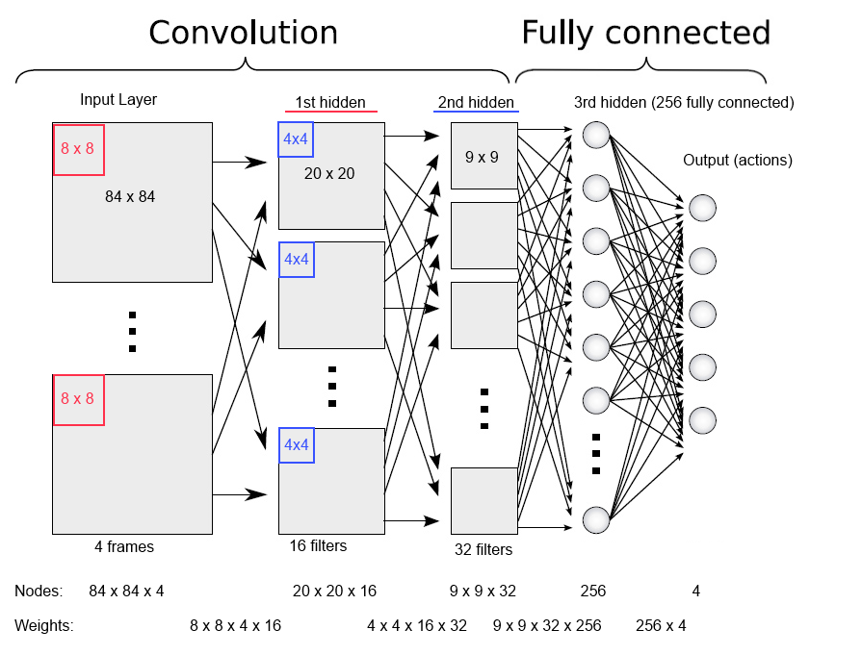
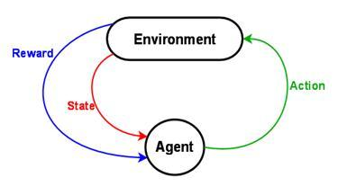
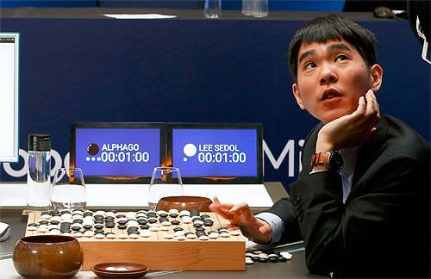
Milestones: Deep Reinforcement Learning
In 2013, Deep Mind’s arcade player bests human expert on six Atari Games. Acquired by Google in 2014,.
In 2016, Deep Mind’s
alphaGo defeats former world champion Lee Sedol
Notes:
Founders: Demis Hassabis, Shane Legg, Mustafa Suleyman
Why was this milestone particularly worrying from an ethics point of view?

Slide 9
Deep Learning: Is it Hype or Hope?

Slide 10
Deep Learning: Is it Hype or Hope?
Yes !

Slide 11
Learning about Deep Neural Networks
Yann Lecun quote: DNNs require: “an interplay between intuitive insights, theoretical modeling, practical implementations, empirical studies, and scientific analyses”
i.e. there isn’t a framework or core set of principles to explain everything (c.f. graphical models for machine learning).
We try to cover the ground in Lecun’s quote.

Slide 12
This Course (please interrupt with questions)
Goals:
Introduce deep learning to a broad audience.
Review principles and techniques (incl. visualization) for understanding deep networks.
Develop skill at designing networks for applications.
Materials:
Book(s)
Notes
Lectures
Visualizations

Slide 13


The role of Animation
From A. Karpathy’s cs231n notes.

Slide 14
Prerequisites
Knowledge of calculus and linear algebra, Math 53/54 or equivalent.
Probability and Statistics, CS70 or Stat 134. CS70 is bare minimum preparation, a stat course is better.
Machine Learning, CS189.
Programming, CS61B or equivalent. Assignments will mostly use Python.

Slide 15
Logistics
Course Number: CS 294-129 Fall 2016, UC Berkeley
On bCourses, publicly readable.
CCN: 34652
Instructor: John Canny lastname@berkeley.edu
Time: MW 1pm - 2:30pm
Location: 306 Soda Hall
Discussion: Join Piazza for announcements and to ask questions about the course
Office hours:
John Canny - M 2:30-3:30, in 637 Soda

Slide 16
Course Project
More info later
Can be combined with other course projects
Encourage “open-source” projects that can be archived somewhere.

Slide 17

Outline – Basics/Computer Vision

Slide 18
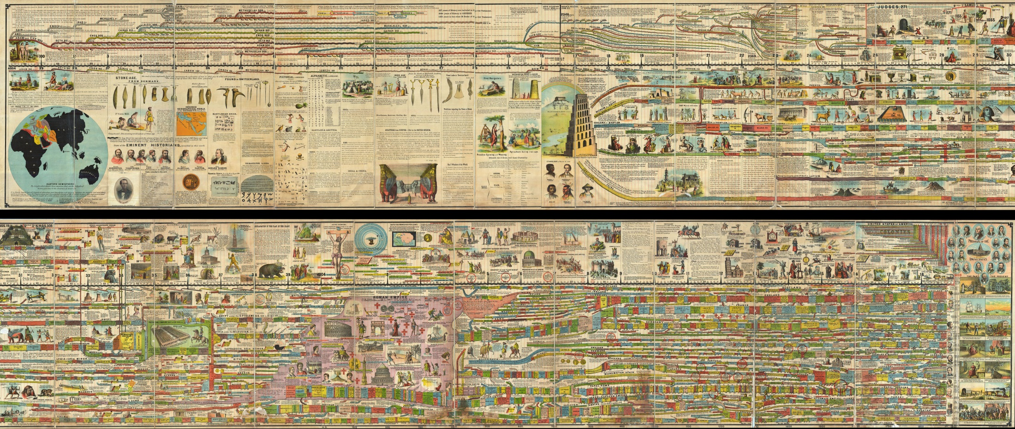
Some History
Reading: the Deep Learning Book, Introduction

Slide 19
Phases of Neural Network Research
1940s-1960s: Cybernetics: Brain like electronic systems, morphed into modern control theory and signal processing.
1960s-1980s: Digital computers, automata theory, computational complexity theory: simple shallow circuits are very limited…
1980s-1990s: Connectionism: complex, non-linear networks, back-propagation.
1990s-2010s: Computational learning theory, graphical models: Learning is computationally hard, simple shallow circuits are very limited…
2006→: Deep learning: End-to-end training, large datasets, explosion in applications.

Slide 20


Citations of the “LeNet” paper
Recall the LeNet was a modern visual classification network that recognized digits for zip codes. Its citations look like this:
The 2000s were a golden age for machine learning, and marked the ascent of graphical models. But not so for neural networks.
Second phase
Deep Learning “Winter”
Third phase

Slide 21
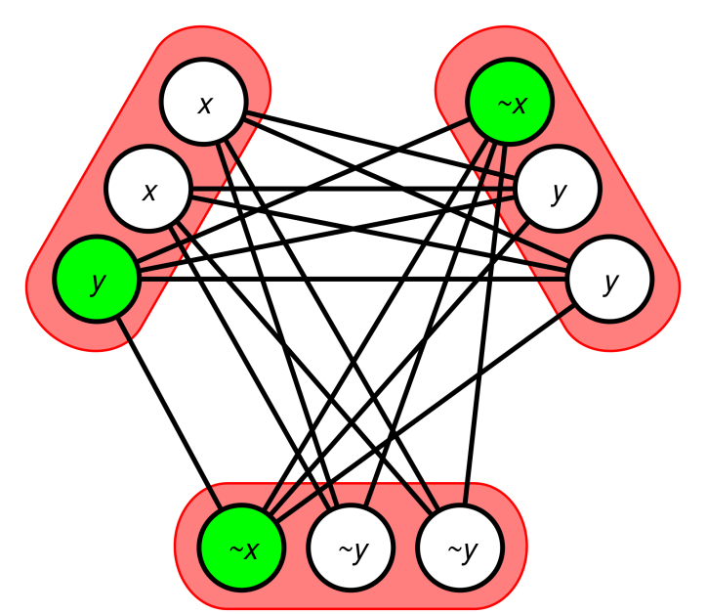
Why the success of DNNs is surprising
From both complexity and learning theory perspectives, simple networks are very limited.
Can’t compute parity with a small network.
NP-Hard to learn “simple” functions like 3SAT formulae, and i.e. training a DNN is NP-hard.

Slide 22
Why the success of DNNs is surprising
The most successful DNN training algorithm is a version of gradient descent which will only find local optima. In other words, it’s a greedy algorithm. Backprop:
loss = f(g(h(y)))
d loss/dy = f’(g) x g’(h) x h’(y)
Greedy algorithms are even more limited in what they can represent and how well they learn.
If a problem has a greedy solution, its regarded as an “easy” problem.

Slide 23
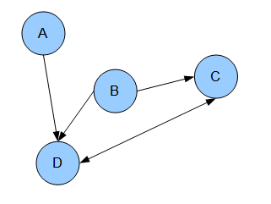
Why the success of DNNs is surprising
In graphical models, values in a network represent random variables, and have a clear meaning. The network structure encodes dependency information, i.e. you can represent rich models.
In a DNN, node activations encode nothing in particular, and the network structure only encodes (trivially) how they derive from each other.

Slide 24
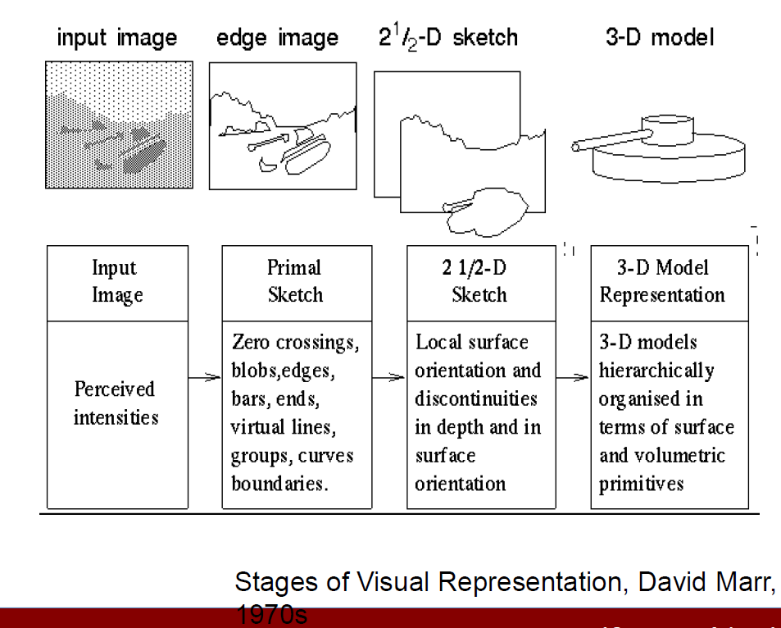
Why the success of DNNs is surprising obvious
Hierarchical representations are ubiquitous in AI. Computer vision:

Slide 25
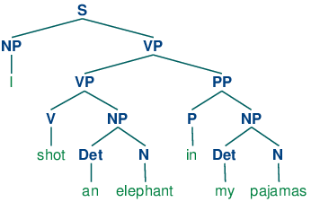
Why the success of DNNs is surprising obvious
Natural language:

Slide 26
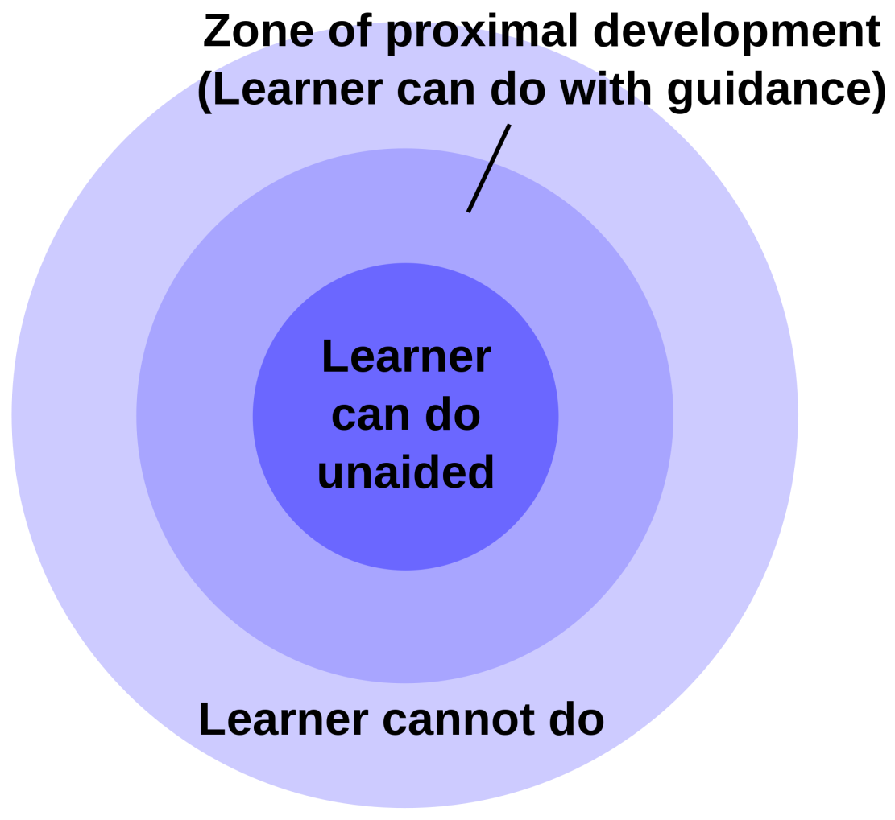
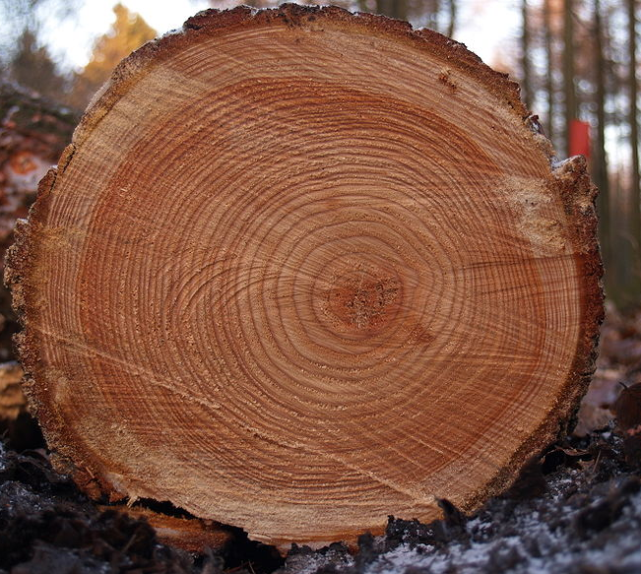
Why the success of DNNs is surprising obvious
Human Learning: is deeply layered.
Deep expertise

Slide 27
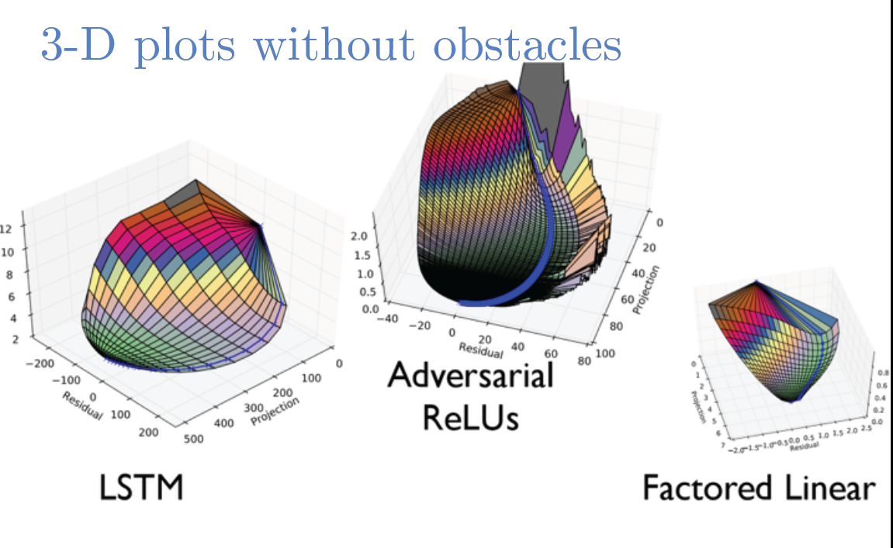
Why the success of DNNs is surprising obvious
What about greedy optimization?
Less obvious, but it looks like many learning problems (e.g. image classification) are actually “easy” i.e. have reliable steepest descent paths to a good model.
Ian Goodfellow – ICLR 2015 Tutorial

